Slide 1
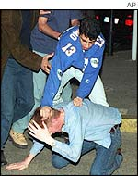
Crimes Against the Person

Slide 2
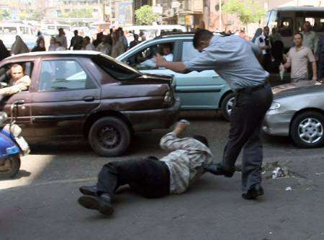
Assault/Battery
These two terms are often used interchangeably in the legal field
Strictly defined:
1. assault = an attempt or threat to carry out a physical attack against another person
2. battery = the actual illegal physical contact that occurs without consent

Slide 3
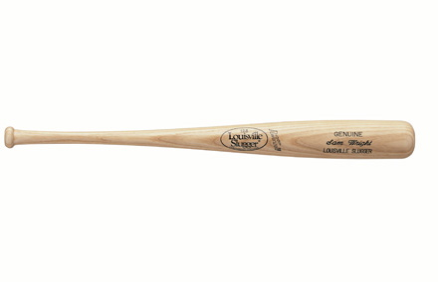
Assault/Battery (continued)
Just like in homicide cases, assault and battery are often issued degrees of severity depending on the situation
Simple Assault/Battery = usually a misdemeanor, could be a fistfight, etc.
Aggravated Assault/Battery = usually a class 1 felony and could involve a weapon or meant to cause serious injury to opposing party

Slide 4
Stalking
Occurs when a person repeatedly follows or harasses another person
Could Include:
1. threats of emotional harm
2. threats of bodily harm
3. thoughts of sexual provocation
Typically, a restraining order follows.
Many states have already passed laws to prosecute those who stalk their victims both physically and on the internet

Slide 5
Sex Crimes
Includes rape (all degrees), sexual assault/sexual battery, child pornography, as well as other crimes
MSNBC’s “To Catch a Predator” series hosted by Chris Hansen (above) has worked with local police and the FBI to trap sexual predators before they can victimize a child

Slide 6
Sex Crimes (cont’d)
Rape
1. defined as sexual intercourse without consent (permission)
2. Different degrees include but are not limited to aggravated (deadly weapon to force victim), and statutory (victim is not of legal age to consent to sex)
In PA, statutory rape AUTOMATICALLY exists when victim is under 16 OR if victim is ages 16-17 and perpetrator is 4 or more years older (class 2 felony)

Slide 7
Sex Crimes (cont’d)
What constitutes “non-consensual sex”?
1. victim physically resists perpetrator
2. victim submits due to force, threat, or physical violence
3. victim is unconscious or intoxicated due to drugs/alcohol

Slide 8
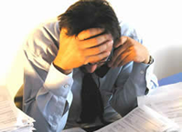
Trying A Rape Case
Difficult for all Parties Involved
1. victims do not always wish to face or testify against accused in court
2. defendants often feel that they are already guilty in the eyes of jurors

Slide 9
Trying a Rape Case (cont’d)
For Prosecutors, they need to shift the jury’s thinking away from a victim’s past sexual history and choices made that the defense might try to introduce
For jurors, many times the argument comes down to “he said-she said”

Slide 11
End of slideshow, click to exit

Slide 12
Bonus Episode!!!

Slide 13
In This Episode…
A graduate student has accused her professor of raping her after a night of drinking. He claims that she initiated it and demanded “rough sex”. Which side is telling the truth?

